Slide 1

An-Najah National University
Student: Amr Shawahneh
Professor: Jihad Hamamra

Slide 2

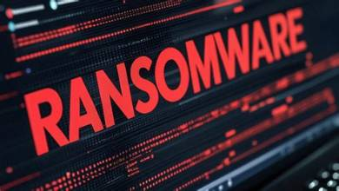
️ Ransomware

Slide 3
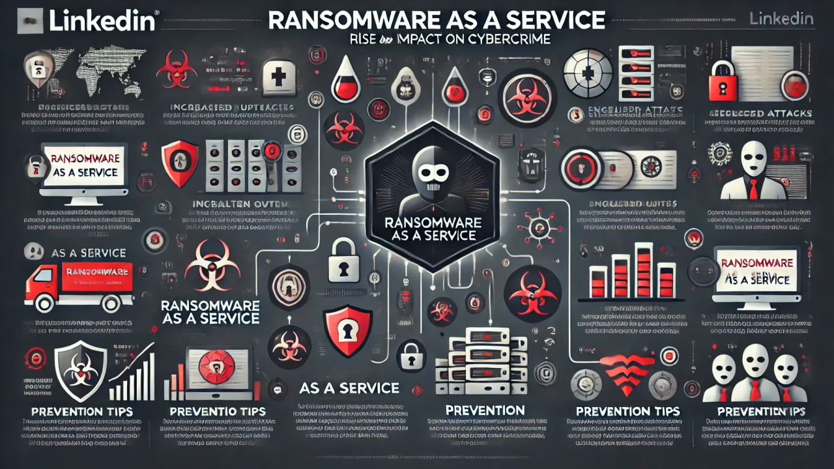

Slide 4
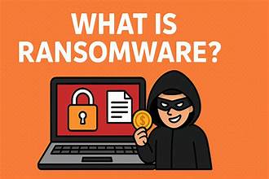
What is Ransomware?
Ransomware is a well-known type of malware that encrypts files or locks an entire system, then demands a ransom—typically in a cryptocurrency )like Bitcoin (in exchange for decryption or restoring access.
One of the most significant and widespread variants is "LockBit," which emerged in 2019 and utilizes "AES-256 + RSA-2048" encryption technology.

Slide 5
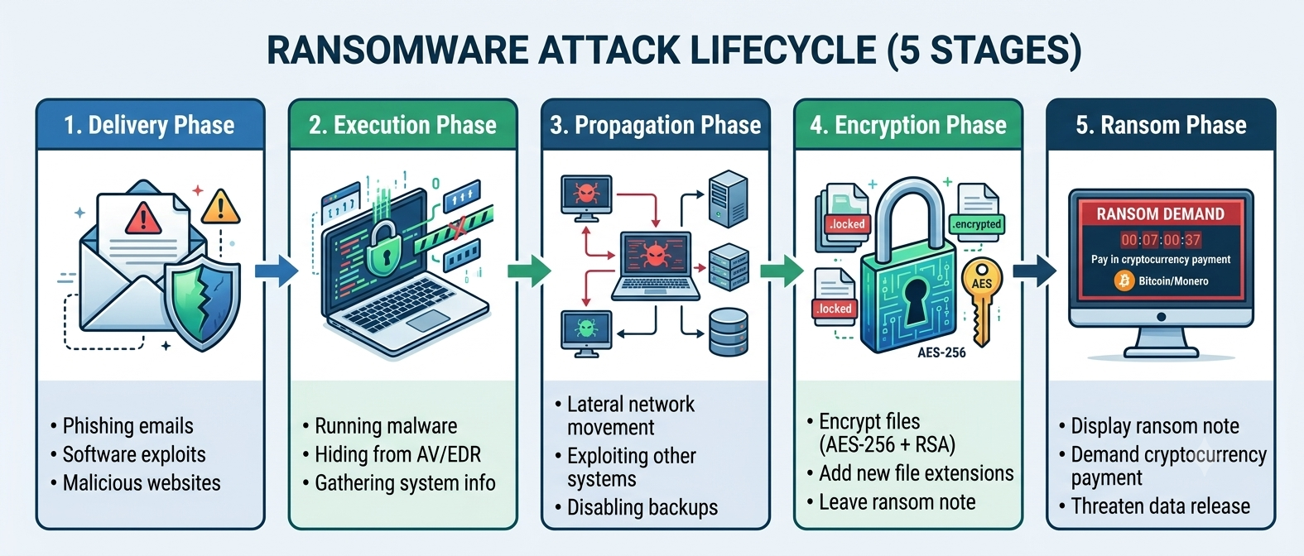
How does Ransomware work?
1. Delivery phase
Phishing emails with malicious attachments
Software exploits
Compromised websites that automatically download malware
Infected USB drives, P2P networks, malicious ads

Slide 6
2. Execution Phase
Running malware on the target system
Hiding from antivirus software
Gathering system information (region, language, system type)

Slide 7
3. Propagation phase
Lateral movement across the internal network
Exploiting vulnerabilities in other systems
Disabling backups before encryption

Slide 8
4. Encryption phase
Encrypt files using strong algorithms (AES-256 + RSA)
Add new file extensions (.locked, .encrypted)
Leave a ransom note in each folder

Slide 9
5. Ransom Phase
Displaying a ransom note on the desktop
Demanding payment of a ransom in cryptocurrency (Bitcoin)
Threatening to release stolen data (double ransom)
Setting a deadline for payment (usually 48-72 hours)

Slide 10

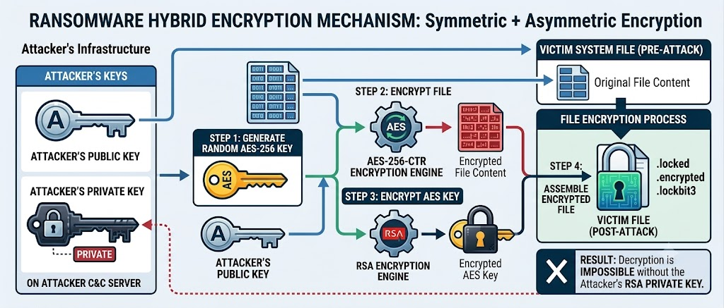
Ransomware Encryption Mechanism

Slide 11
Symmetric + Asymmetric Encryption (Hybrid Encryption)
Hybrid Encryption Mechanism
For each file that is encrypted:
1. A random AES-256 key (symmetric key) is generated
2. The file is encrypted using AES-256-CTR or ChaCha20
3. The AES key is encrypted using the attacker's RSA public key
4. The encrypted key is added to the end of the encrypted file
Result: Decryption is impossible without the attacker's RSA private key

Slide 12
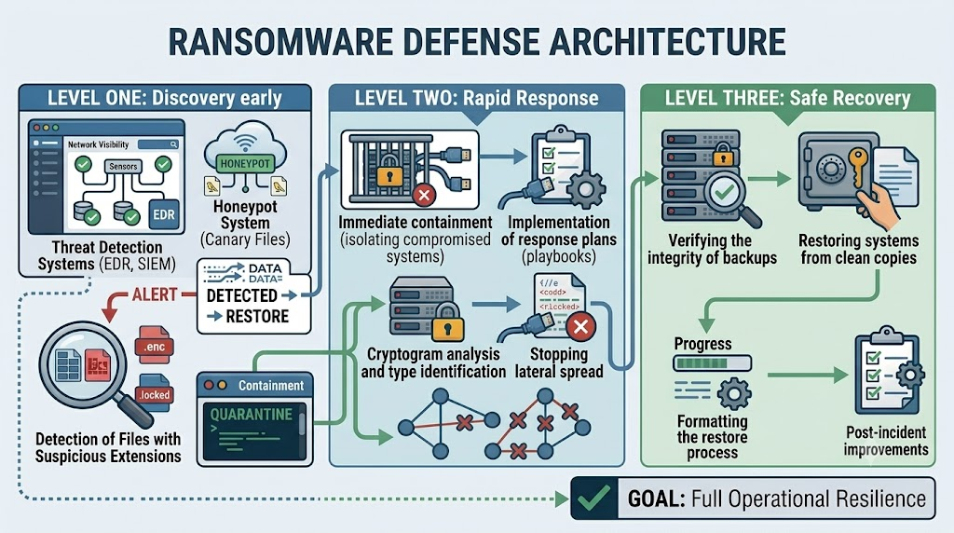
Ransomware Defense Strategies

Slide 13
Level One: Discovery early
Threat Detection Systems (EDR, SIEM)
Honeypot System (Canary Files)
Entropy Monitoring
Detection of Files with Suspicious Extensions

Slide 14
Level Two: Rapid Response
Immediate containment (isolating compromised systems)
Cryptogram analysis and type identification
Stopping lateral spread

Slide 15
Level Three: Safe Recovery
Verifying the integrity of backups
Restoring systems from clean copies
Formatting the restore process
Post-incident improvements

Slide 16
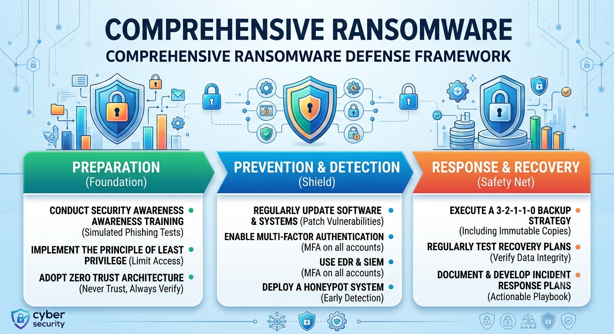
Ransomware Defense

Slide 17
Ransomware Defense Best Practices
Regular backups (3-2-1-1-0 Backup)
Enable MFA on all accounts
Implement the Principle of Least Privilege
Use EDR / SIEM
Use a Honeypot system for early detection

Slide 18

Having considered the concept of ransomware, the stages of confrontation, and the three best defense strategies, we now move to the practical side. The following 10 skills represent a practical application of everything explained theoretically, covering all stages of ransomware defense: stress, compensation, recovery, and analysis.

Slide 19
Skill 1: Ransomware Tabletop Exercise Template
Conduct a ransomware attack simulation exercise with the security and leadership team. This exercise tests preparedness and interdepartmental coordination without the use of technology.
A scenario involving a ransomware attack (such as LockBit) is presented. The decisions to be made at each stage of the attack are explained, and the decisions and lessons learned are documented.

Slide 20
Skill 2: Ransomware Playbook Automation Agent
Developing an AI agent that prints out ransomware incident patterns, mimicking tools like CrowdStrike, Splunk, and MalwareBazaar.
It selects its target audience (a process that can take hours), and the agent automatically executes all steps in seconds, recording each step in the organizer's report.

Slide 21
Skill 3: Ransomware Honeypot Deployment Template
Deploy a honeypot (fake access) system to detect ransomware attacks using canary files that are triggered when a ransomware attack occurs. Dummy files are placed in sensitive folders (such as Finance, HR). These files are not used by any employee. If an employee accesses them, it means the attack is present and immediately free.

Slide 22
Skill 4: Ransomware Response Agent
To develop an intelligent agent (AI agent) for a structured ransomware incident response, performing six key tasks from ransomware identification to report generation.
The agent automates the entire response process from start to finish: identifying the ransomware type, verifying decryption tools, assessing the impact, creating a containment list, developing a recovery plan, and generating a comprehensive report.

Slide 23
Skill 5: Performing Ransomware Response
Implementing a structured ransomware incident response from detection to post-incident improvements, with a practical application of the SANS PICERL framework.
This skill puts into practice what is explained theoretically in defense strategies. All phases of the response are implemented: detection, containment, impact assessment, decision-making, recovery, and recovery.

Slide 24
Skill 6: Ransomware Recovery Orchestration and Tracking Tool
To coordinate and track the system recovery process after a ransomware attack, managing dependencies and monitoring compliance with RTO (Recovery Time Objective) standards.
Recovering systems after a ransomware attack is a complex process. Some systems depend on others and must be restored in a specific order. This agent organizes this process and tracks its progress.

Slide 25
Skill 7: Ransomware Backup Strategy Audit
Auditing your AWS backup strategy to ensure it's resilient against ransomware attacks.
Backups are the last line of defense against ransomware. But what if the backups themselves are encrypted or corrupted? This skill checks six key aspects to ensure backup integrity.

Slide 26
Skill 8: Ransomware Encryption Analysis Report
Analyze the encryption mechanism used in a ransomware attack and assess the possibility of decryption to determine the best path to recovery.
Not all ransomware attacks are created equal. Some use strong encryption, while others contain vulnerabilities that can be exploited. This skill analyzes the encryption mechanism and provides recommendations for recovery.

Slide 27
Skill 9: Investigating Ransomware Attack Artifacts
Investigating ransomware attack artifacts and extracting indicators of compromise (IOCs) from ransomware notes and encrypted files.
Ransomware notes and encrypted files contain valuable information that can be used to understand the attack and prevent future attacks. This skill extracts and organizes this information.

Slide 28
Skill 10: Testing Ransomware Recovery Procedures
Testing and verifying data recovery procedures after a ransomware attack, with actual RTO (Recovery Time Objective) and RPO (Recovery Point Objective) calculations.
Backups alone are not enough; they must be tested regularly to ensure they are recoverable. This skill performs a comprehensive test of recovery procedures.

Slide 29
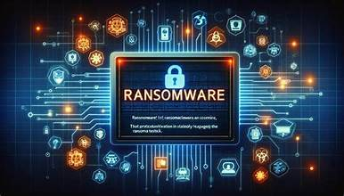
Thank you

